Slide 1
Flip-flops

Slide 2
outline
Flip-Flops (FF): NAND gate latch, NOR gate latch, D latch,
clock signals and clocked FFs, clocked S-C FF

Slide 3
introduction
The logic circuits such as combinational circuits whose output levels at any instant of time are dependent on the levels present at the inputs at that time. Any prior input level conditions have no effect on the present outputs because combinational logic circuits have no memory.
Most digital systems consists of both combinational circuits and memory elements.

Slide 4
Flip-flop (FF)
FF is a memory element, made up of logic gates.

Slide 5
Flip-flop (FF)
A FF can have one or more inputs. This inputs are used to cause the FF to switch back and forth (flip-flop) between its possible output states. Most FF inputs need only to be momentarily activated (pulse) in order to cause a change in the FF output state, and the output will remain in that new state even after the input pulse is over. This is the FF’s memory characteristic.

Slide 6

Flip-flop (FF)
Figure shows a general symbol of FF. It shows two outputs $Q and \overline{Q}.$It may represents as $Xand \overline{X}, A and \overline{A}$ etc. One is normal output and other is inverted output. The state of a FF referring to the state of it’s normal output. If we say a FF is in the HIGH state, we mean $Q$=1. If we say FF is in LOW state, we mean $Q$=0. Of course the $\overline{Q}$ state will always be the inverse of $Q$.
HIGH state= SET state= setting the FF
LOW state=CLEAR/RESET state= clearing or resetting the FF.
Note: Many FF have a SET input or a CLEAR input that is used to drive the FF into a specific output state.

Slide 7
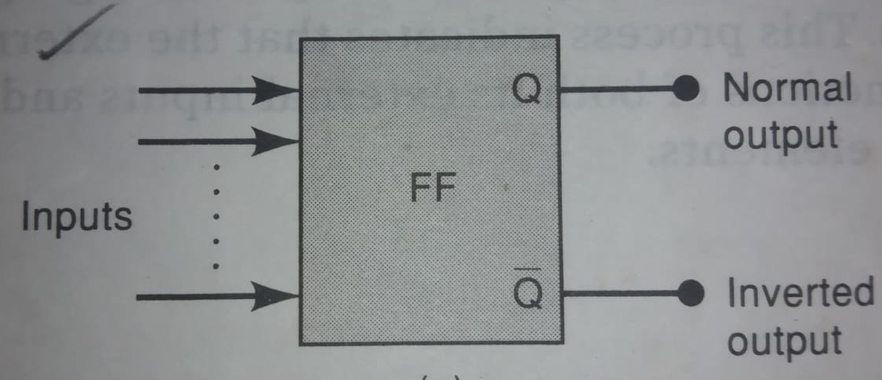
Flip-flop (FF) (a)

Slide 8
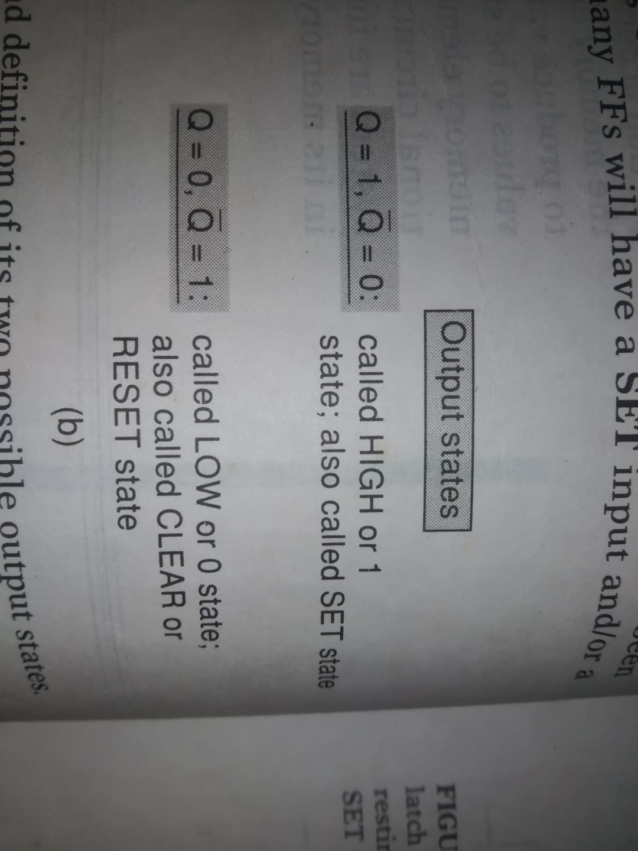
Flip-flop (FF) (B)

Slide 9
Flip-flop (FF)
It is known as bi-stable multivibrator.
Certain types of FFs known as latch.

Slide 10
Latch

Slide 11
1. No change stage

Slide 12
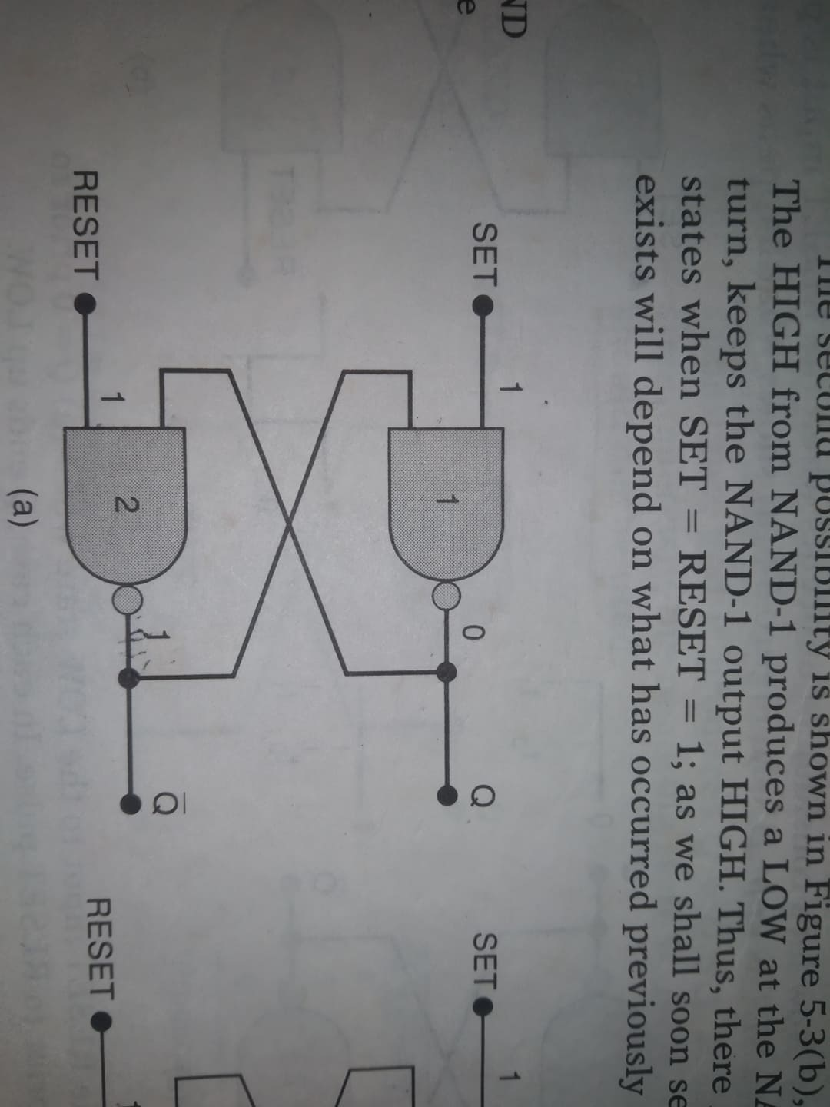
NAND Gate Latch (a)

Slide 13
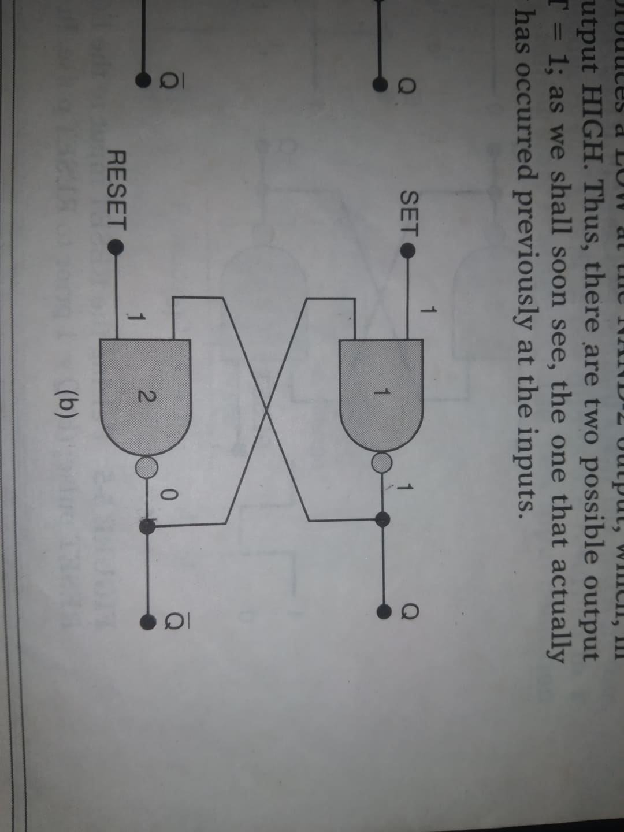
NAND Gate Latch (B)

Slide 14

NAND Gate Latch
Figure (a) shows, two NAND gates are cross-coupled so that the output of NAND-1 is connected to one of the inputs of NAND-2 and vice-versa. The gate outputs, labeled $Q and \overline{Q}$ respectively, are the latch output. Under normal conditions, these output will always be the inverse of each other. There are two latch input: SET and RESET. SET input sets $Q=1$ and RESET input resets $Q=0$.
At first, SET=RESET=1, we have $Q=0 and \overline{Q}=1 \left(see fig.\right)$. With $Q=0,$input of NAND-2 are 0 and 1. Which produce $\overline{Q}=1$. Again, $\overline{Q}=1$ causes NAND-1 to have both inputs 1 which produce $Q=0$.

Slide 15

NAND Gate Latch
Figure (b) shows, $Q=1 and \overline{Q}=0.$HIGH output from NAND-1 is the input to NAND-2 produces a LOW output, which in turn keeps the NAND-1 output HIGH. Thus, there are two possible output states when SET=RESET=1 .

Slide 16
2. SET

Slide 17
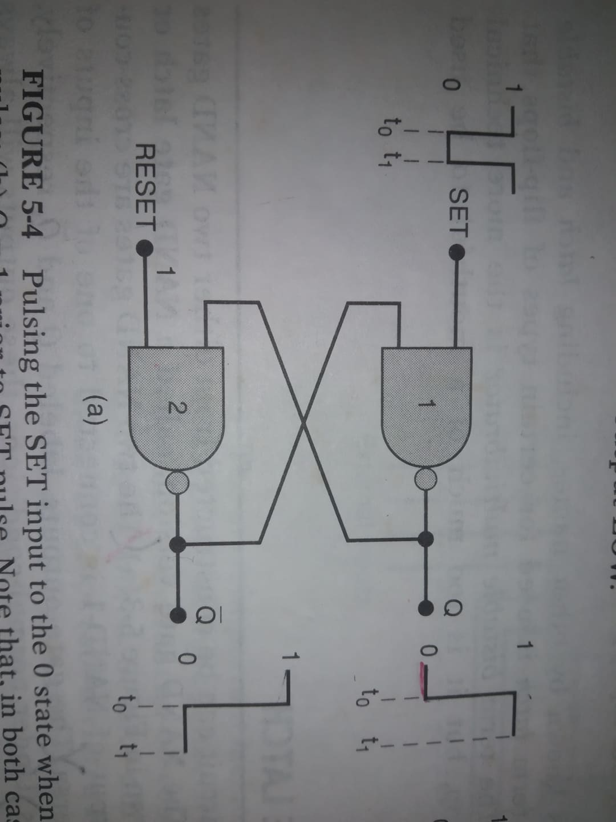
Setting the latch

Slide 18
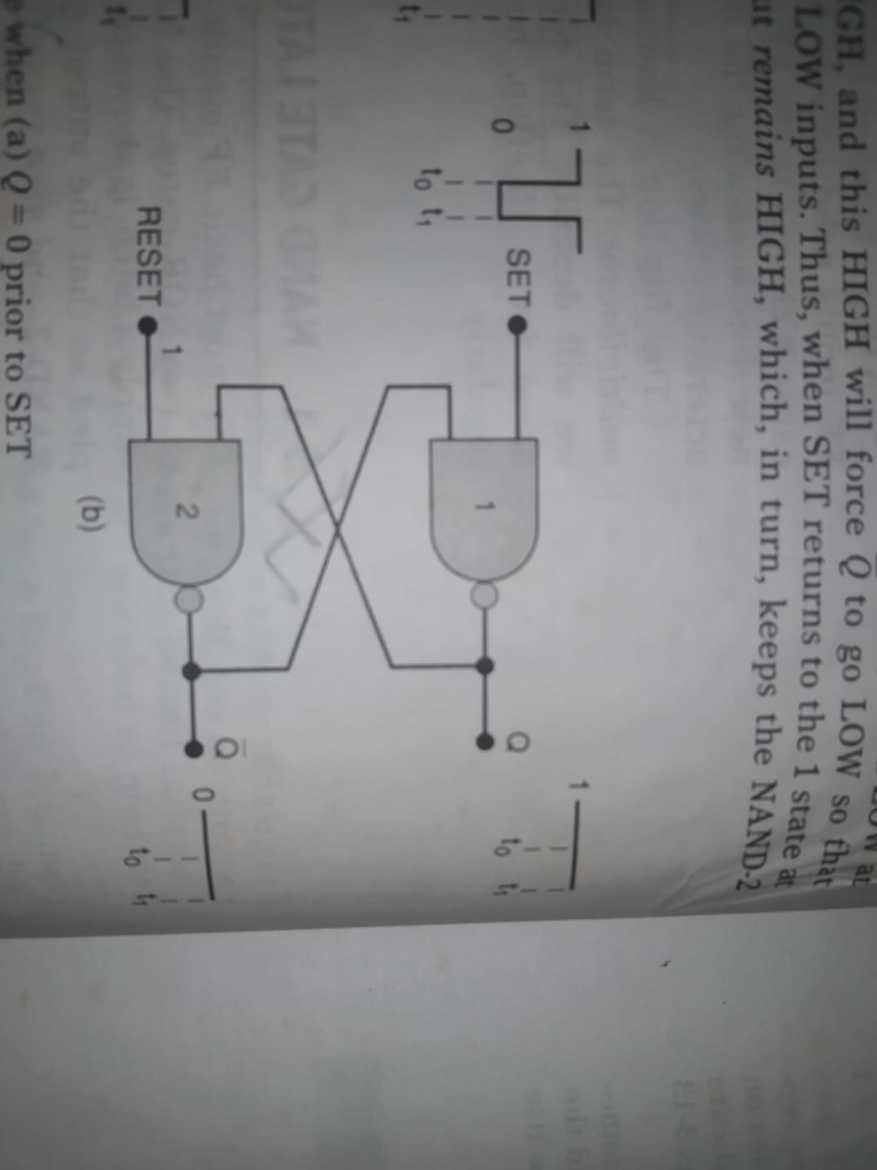
Setting the latch

Slide 19

Setting the Latch
Let’s investigate what happens when the SET input is momentarily pulsed LOW while RESET is kept HIGH. $Q=0$ prior to the occurrence of the pulse. As SET is pulsed LOW at time t₀ Q will go HIGH ($Q=1$), this HIGH will force $\overline{Q}$to go LOW ($\overline{Q}$=0). So that NAND-1 has two LOW inputs. Thus, when SET returns to HIGH (1) state at t₁. NAND-1 output remains HIGH, which in turn keeps the NAND-2 output LOW.

Slide 20

summary
LOW pulse on the SET input will always cause the latch to end up in the $Q=1$ state. This operation is called setting the latch or FF.

Slide 21
3. reSET

Slide 22
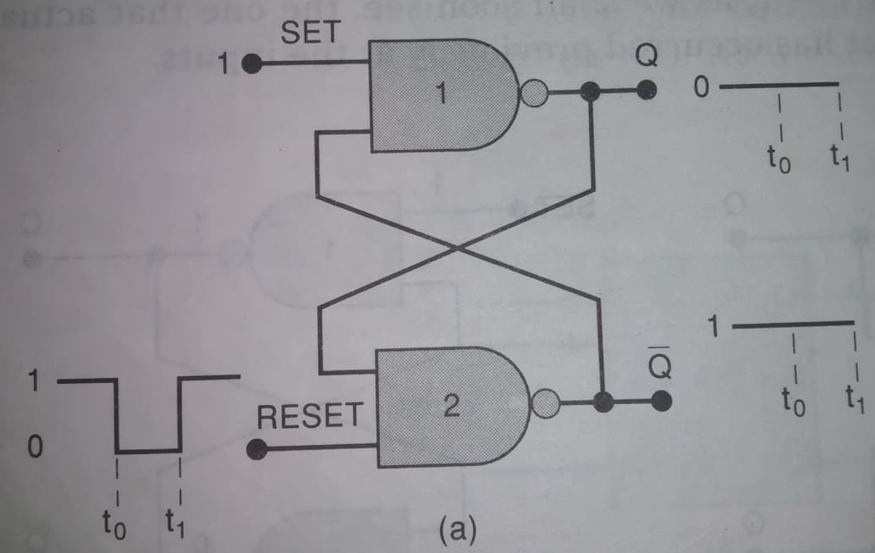
resetting the latch

Slide 23
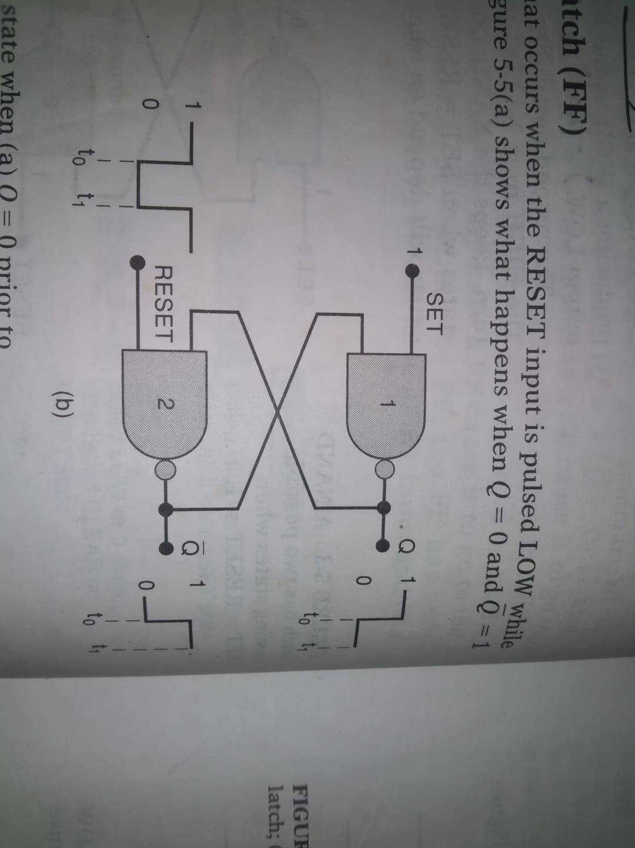
resetting the latch

Slide 24

reSetting the Latch
When the RESET input is pulsed LOW while SET is kept HIGH. Figure (a) shows, prior to the application of the pulse $Q=0$ and $\overline{Q}$=1. Since $Q=0$ is already keeping the NAND-2 output HIGH, the LOW pulse at RESET will not have any effect. When RESET returns HIGH (at t₁), the latch outputs are still $Q=0$ and $\overline{Q}$=1.

Slide 25

reSetting the Latch
Fig. (b) shows the situation where $Q=1$, prior to the occurrence of the RESET pulse. As RESET pulsed LOW at t₀,$\overline{ Q}$will go HIGH ($\overline{Q}$=1). This high forces $Q$to go LOW so that NAND-2 now has two LOW inputs. Thus when RESET returns HIGH at t1, the NAND-2 output remains HIGH which in turns keeps the NAND-1 output LOW.

Slide 26

summary
LOW pulse on the RESET input will always cause the latch to end up in the $Q=0$ state. This operation is called clearing or resetting the latch or FF.

Slide 27
Question
1. Where should pulse be applied, when you need to 'set' a latch?
2. Where should pulse be applied, when you need to ‘clear' a latch?

Slide 28

Summary of NAND latch
SET=RESET=1. This condition is the normal resting state and it has no effect on the output state.
SET=0, RESET=1. This will always cause the output to go to the $Q=1$ state, where it will remain even after SET returns HIGH. This is called setting the latch.
SET=1, RESET=0. This will always produce the $Q=0$state, where the output will remain even after RESET remains HIGH. This is called clearing the Latch.
SET=RESET=0. This condition tries to set and clear the latch at the same time and it produces $Q=\overline{Q}$=1. If the inputs are returned to 1 simultaneously, the resulting state is unpredictable. This input condition should not be used.

Slide 29
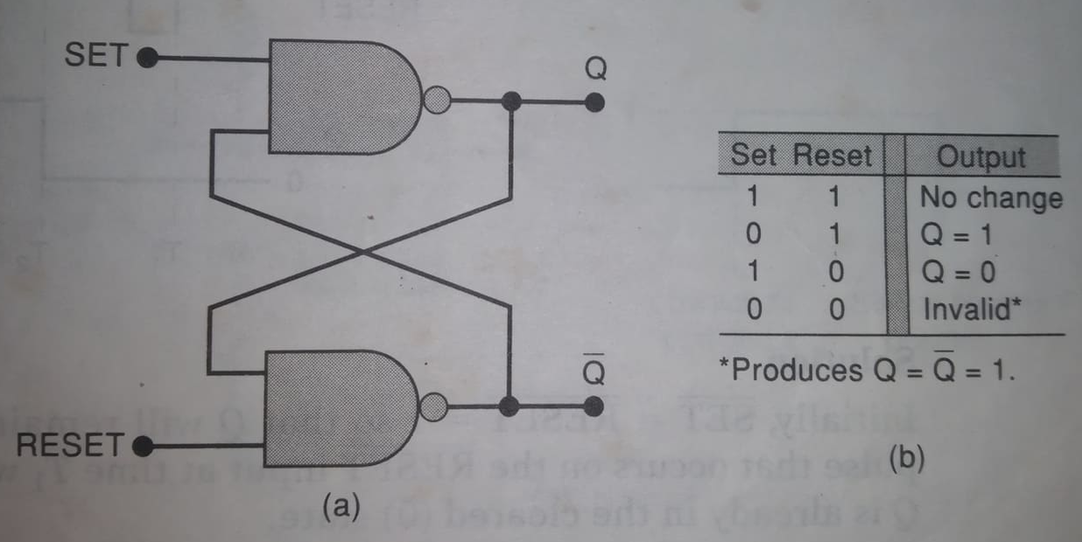
Summary of NAND latch

Slide 30
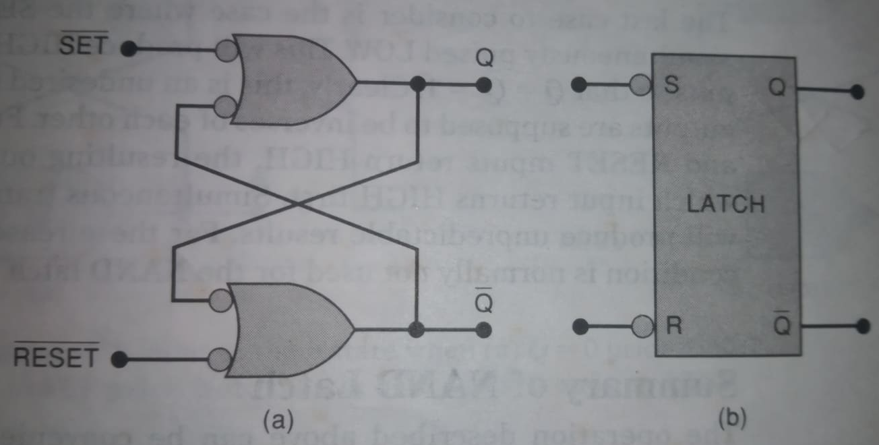
Alternate representation

Slide 31
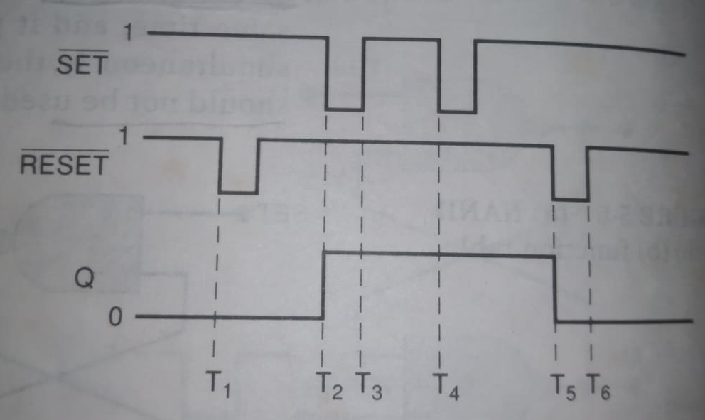
Example: NAND latch waveform

Slide 32
Nor gate latch
(Home work)

Slide 33
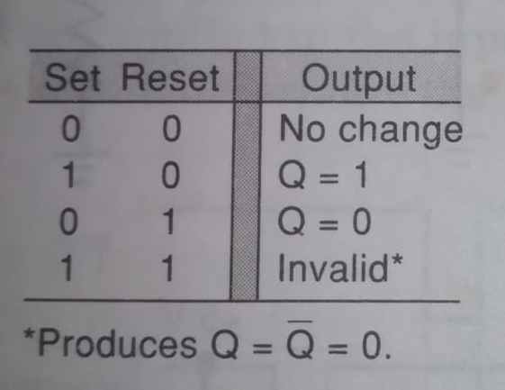
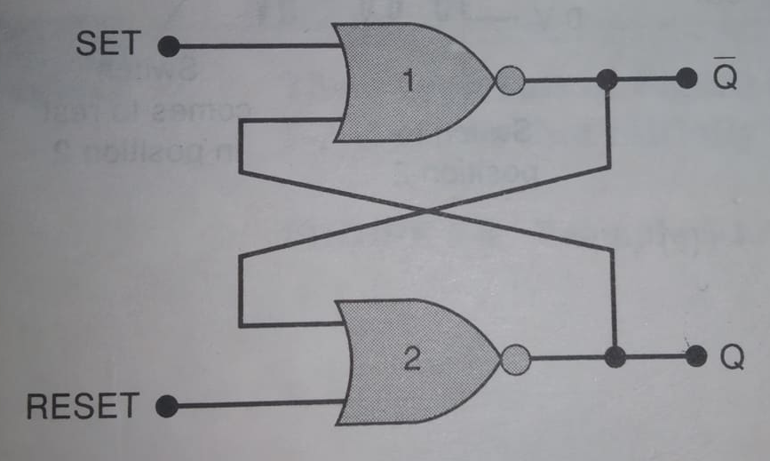
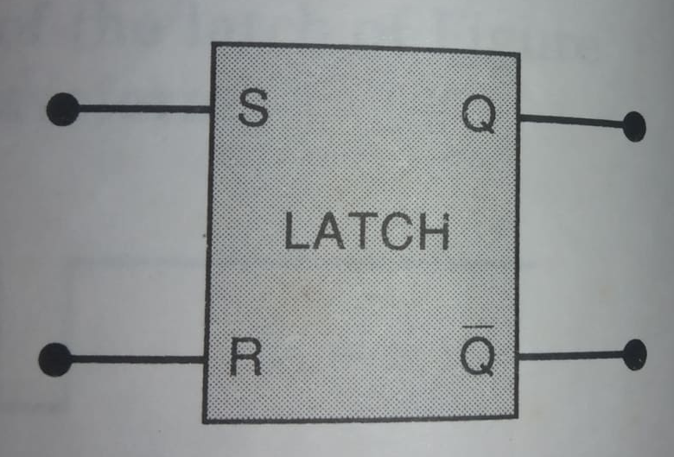
Nor gate latch

Slide 34
Nor gate latch
Operation of NOR latch can be performed in exactly the same manner as for the NAND latch. The results are given in the function table.

Slide 35

Summary of Nor latch
SET=RESET=0. This condition is the normal resting state for NOR latch, and it has no effect on the output state.
SET=1, RESET=0. This will always set $Q=1$, where it will remain even after SET returns to LOW (0). This is called setting the latch.
SET=0, RESET=1. This will always clear $Q=0$, where it will remain even after RESET returns to LOW (0). This is called clearing the Latch.
SET=RESET=1. This condition tries to set and clear the latch at the same time and it produces $Q=\overline{Q}$=1. If the inputs are returned to 0 simultaneously, the resulting output state is unpredictable. This input condition should not be used.

Slide 36
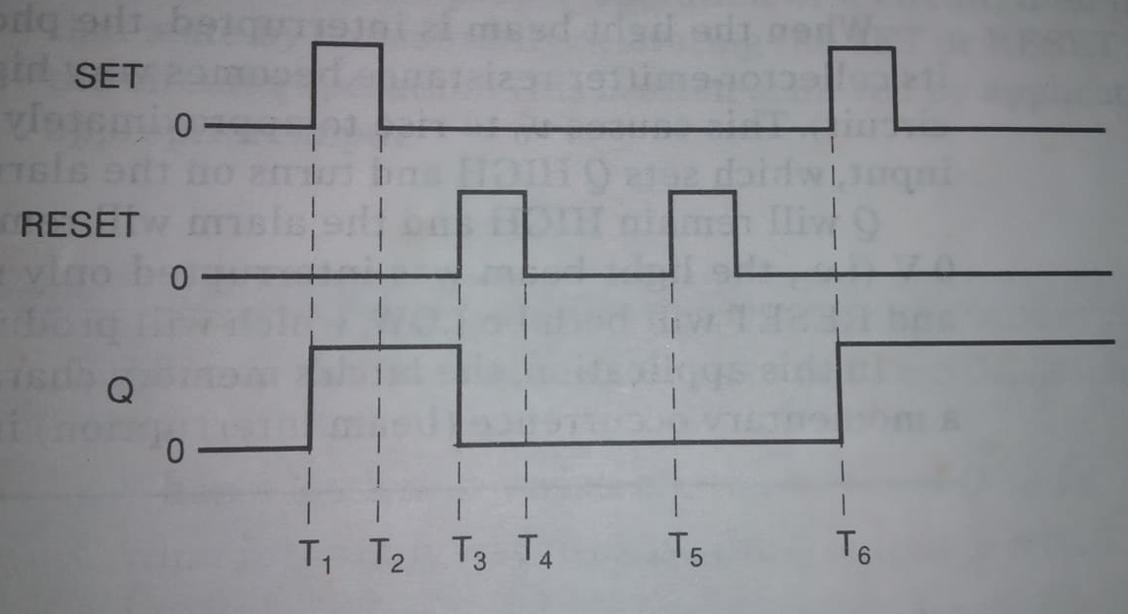
Example: NOR latch waveform

